Slide 1
Opening A Restaurant in Toronto
Capstone Project

Slide 2
Business Problem

Slide 3
Business Problem
Location is probably the single most important factor an entrepreneur needs to consider, especially for service business such as a restaurant
Toronto, or any other major city, will already have a vast number of restaurants scattered throughout the city so where does one begin to decide what type of restaurant to open and where
Census information provides a wealth of information about the people who live in the areas of the city. Can we use Toronto census information to help determine where and what type of restaurant to open?

Slide 4
Description of Data

Slide 5
Description of Data
Statistics Canada provides census data, the most recent being from 2016
Census data can be obtained broken down into forward sortation areas (FSA), which are the first three charters of a Canadian postal code.
The census data is provided in the form of name/value table and thus needs to be transformed to make use
There are 2247 name/value pairs for each FSA, not all may apply for the restaurant analysis
Four Square provides venue information given geo-coordinates
Provide all types of venues including restaurants
Other Data
FSA/Postal Codes data that make up the city of Toronto
Geo-coordinates and Geo-JSON for Toronto (for visualization)

Slide 6
Methodology

Slide 7
General Approach
Group neighbourhoods that are similar based on (a subset of) the census data for the neighbourhood
A neighbourhood will be based on the FSA/postal code
Within each group of neighbourhoods, find the most common restaurants/venues for each neighbourhood and compare within the group
If most of the neighbourhoods in the group have a common restaurant, but another neighbourhood in the group does not, it is an opportunity to open that type of restaurant in the neighbourhood
For example, if 10 neighbourhoods in a group of 12 have Japanese restaurants, then it is an opportunity to open a Japanese restaurant in the other two neighbourhoods.

Slide 8
Grouping Neighbourhoods Using Census Data
A neighbourhood will be based on the FSA/postal code
Grouped neighbourhoods will be based on the following census information
Age distribution (e.g., # people 0-4, 5-9, etc.)
Household after-tax income distribution (e.g., households < $5,000, $5000-$9999, etc.)
Family type distribution (e.g., married with no children, single parent, single, etc.)
Because each FSA/postal code will have a varying population sizes, percentages will be used instead of absolute numbers.
Kmeans will be used to group the neighbourhood into 6 clusters

Slide 9
Results & Discussion

Slide 10
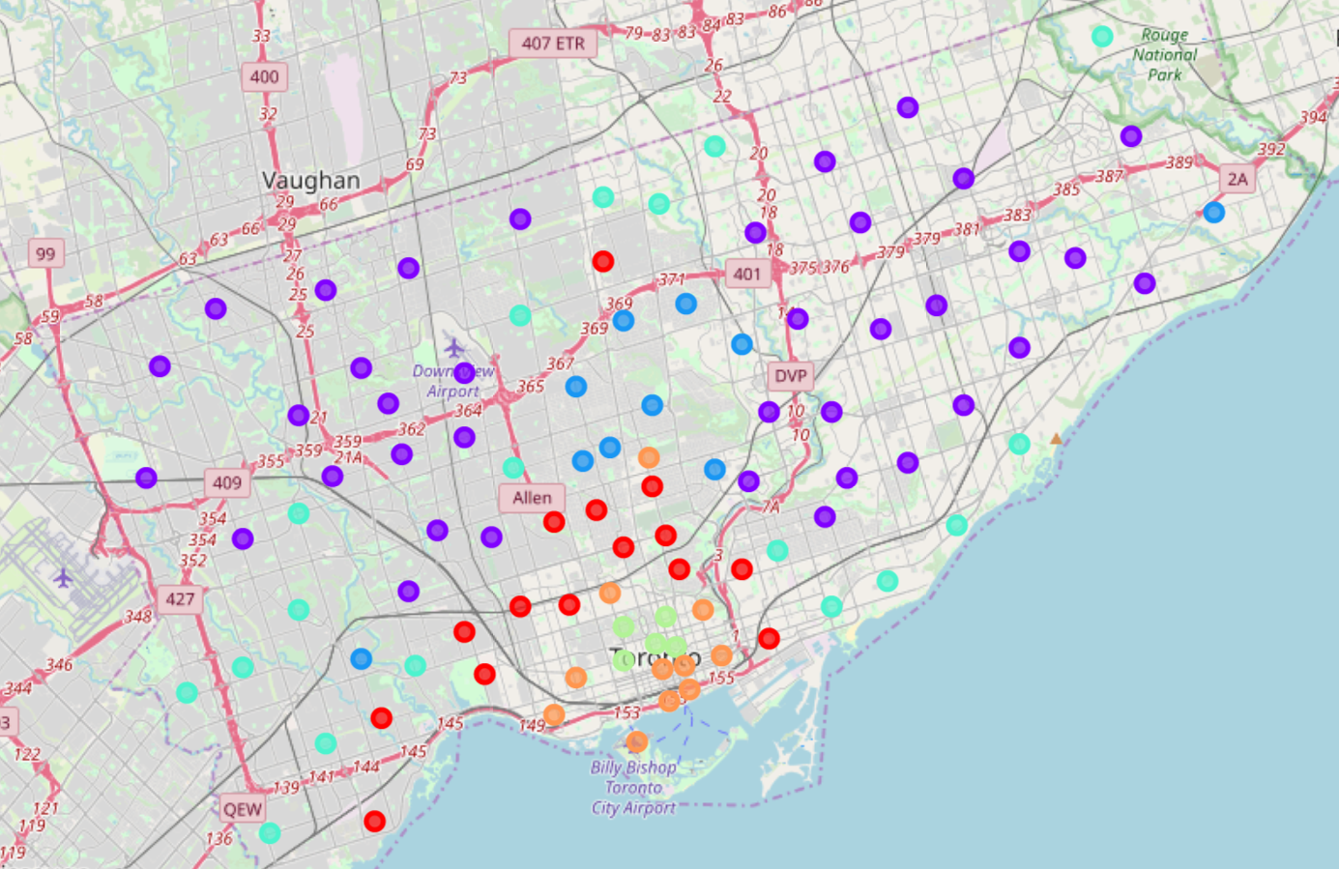
Summary of Grouped Neighbourhoods
Cluster 0: high income and high ratio of singles and families without children
Cluster 1: balanced distribution across income, family type and age groups
Cluster 2: very high income and high ratio of families with children
Cluster 3: very similar to Cluster 1 (balanced distribution)
Cluster 4: high ratio of young, single, adults with low income (predominantly a university area)
Cluster 5: high ratio of young adults and families without children but with a regular income distribution

Slide 11
Opening a Coffee Shop or Café
Overall, a coffee shop or Café is one of the most common restaurants in almost every single neighbourhood of Toronto except for:
L'Amoreaux West
Malvern/Rouge
Upper Rouge
This presents an opportunity to open a coffee shop/café in these neighbourhoods

Slide 12
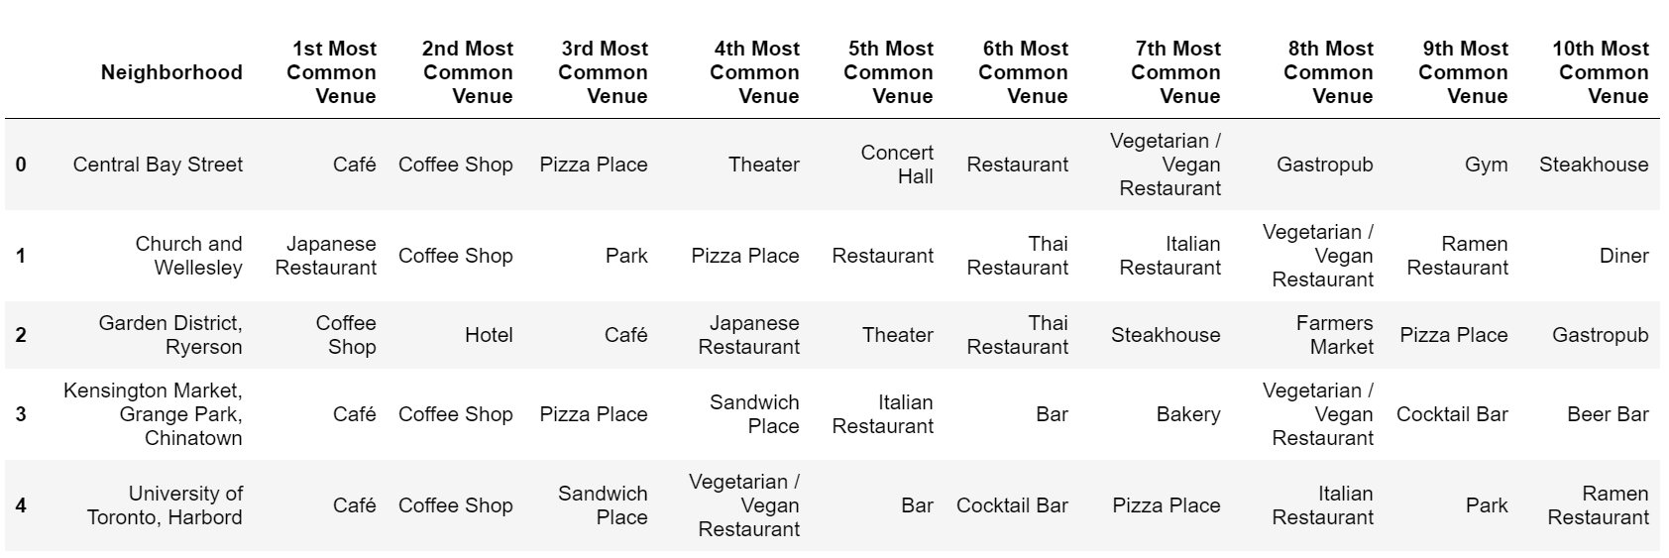
Opening A Vegan Restaurant
Vegetarian/Vegan restaurants were one of the top venues for four out of the five neighbourhoods in Cluster 4.
A Vegan restaurant could be opened in the Garden District/Ryerson neighbourhood

Slide 13
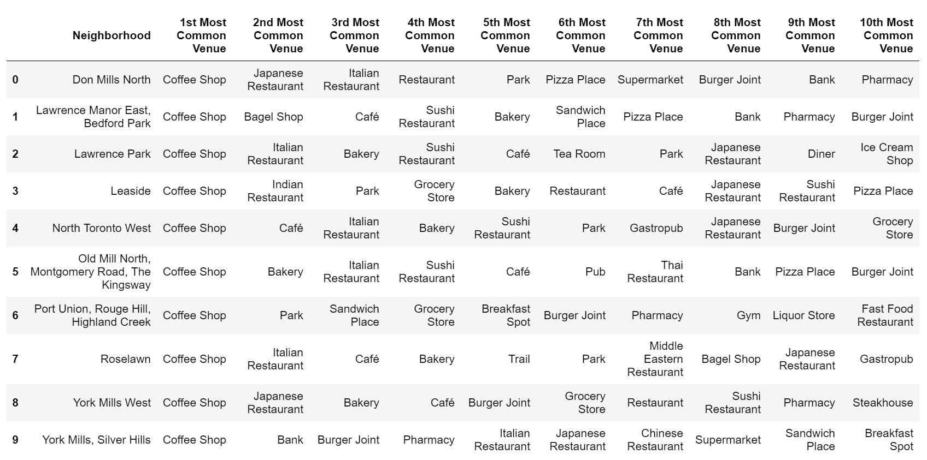
Opening A Japanese Restaurant
Japanese/Sushi restaurants were common in 9 out of 10 neighbourhoods in Cluster 2
A Japanese/Sushi restaurant could be opened in the Port Union/Rouge Hill/Highland Creek neighbourhood

Slide 14
Opening An Italian Restaurant
Cluster 0 had Italian restaurants as top venues in 11 out of the 15 neighbourhoods. In fact, 8 of those neighbourhoods had Italian restaurants as the top 3 most common venues.
Cluster 5 had Italian restaurants as top venues in 9 out of 11 neighbourhoods
This is an opportunity to open an Italian restaurant in the following neighbourhoods:
Cluster 0: Christie, Mimico South, Willowdale South, and Studio District
Cluster 5: Richmond/King/Adelaide and St. James Town

Slide 15
Conclusions & Further Analysis

Slide 16
Conclusions
Leveraging census data together with Four Square data, recommendations for where and what type of restaurants were provided for the City of Toronto
Provided recommendations for:
6 neighbourhoods for Italian restaurants
1 neighbourhood for Vegan/Vegetarian restaurants
2 neighbourhoods for Japanese restaurants

Slide 17
Further Analysis
The results presented base the grouping of neighbourhoods on three areas – age groups, after-tax household income, and family types.
Information such as language spoken, immigration, and ethnic origin could improve the clustering and provide more insight into underserved neighbourhoods
Two clusters (Cluster 1 and Cluster 3) has a high number of neighbourhoods in the cluster and could be further segmented using language/immigration/ethnicity to help recommend restaurants

